Slide 1



SUPPLY CHAIN INVENTORY MANAGEMENT
“OPTIMIZING INVENTORY FOR A SEAMLESS SUPPLY CHAIN”

Slide 2
TEAM MEMBERS:
Priyanka V
Priyadharshini B
Priyanka M
Priyadarshan V J
Lakshmi C R
Tharani K
COURSE INSTRUCTORS:
Dr. Ramesh Rajagopalan
Dr. Novin Ghaffari
KEY MEMBERS OF SPONSORING COMPANY:
Venugopal K [ZF-Group]
Sreenivasan [ZF-Group]

Slide 3

INTRODUCTION
Effective inventory management is crucial for businesses dealing with physical products or goods.
The project's goal is to optimize the overall inventory management process, reduce costs, improve efficiency, and enhance customer service.
The project outcome will provide valuable insights into inventory management that can be applied to other businesses or industries dealing with physical products or goods.

Slide 4

PROJECT OBJECTIVE
Which Part/Assemblies Are Contributing More?
Do We See A Trend And What Is Impacting The Inventory?
How Do We Predict/Prescribe The Minimum Required Inventory With Current Data?

Slide 5

PROJECT OUTLINE
Basic Analysis of the data given
Identifying the material which contributes more in the given data
Visual representation of the trend in the inventory
Managing a seamless inventory

Slide 6
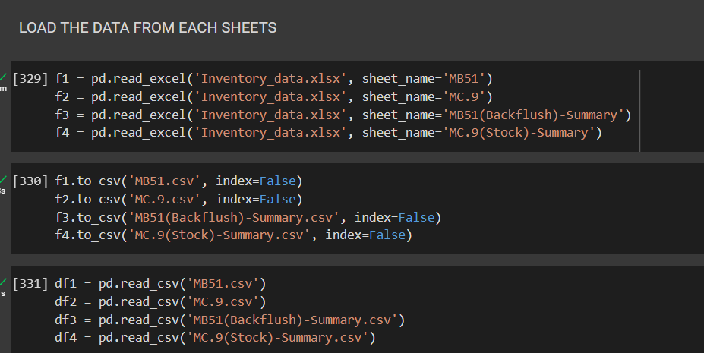
IMPLEMENTATION
Data Collection
Data Cleaning and Preparation
Data Analysis
Inventory Management
Reporting

Slide 7
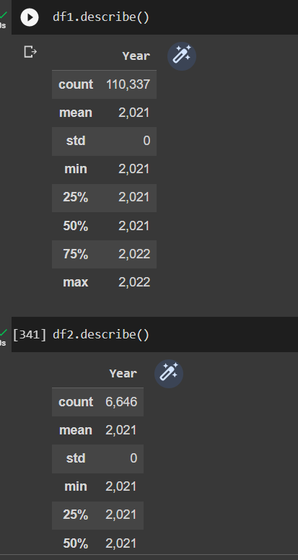
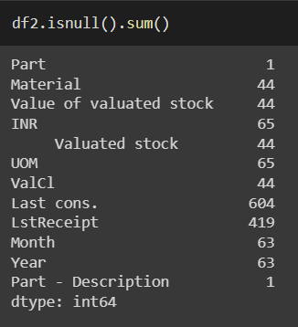
BASIC ANALYSIS
Check the data dimensions and basic information using the shape, info, and describe functions.
Check for missing or null values using the isnull and sum functions.
Check for duplicates using the duplicated and sum functions and further explorations.

Slide 8
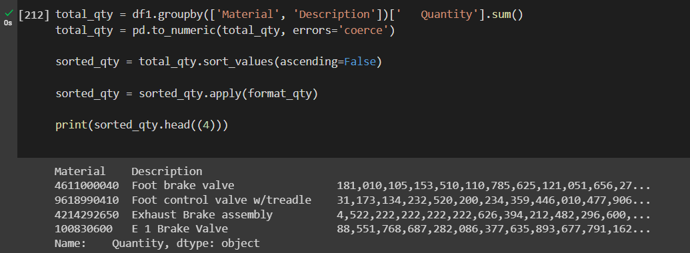
PARTS CONTRIBUTION
The output above shows the total quantity for each material and part description.The quantity column is formatted with commas to make it more readable.The material are sorted in descending order based on the total quantity

Slide 9
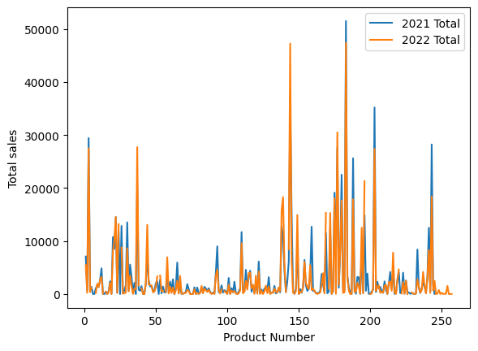
ANALYZING TRENDS

Slide 10
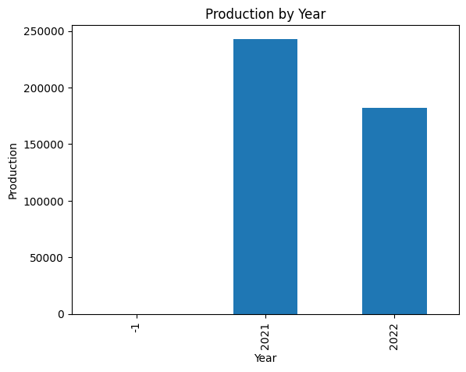
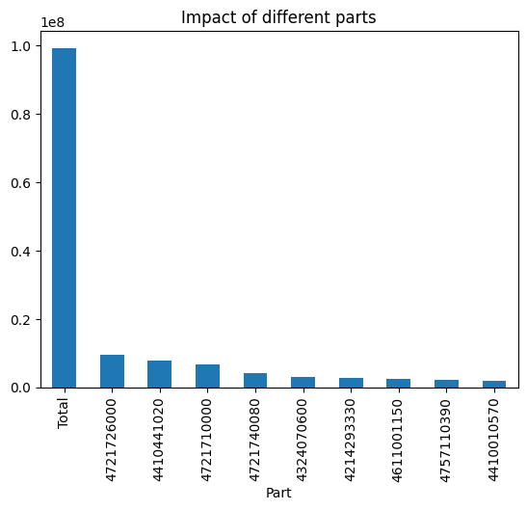
PRODUCTION IMPACTS

Slide 11

MANAGING INVENTORY
The reorder point is the level of inventory at which a new order must be placed to avoid stockout. It takes into account the lead time, demand rate, and safety stock. The formula for reorder point is:
Reorder point = (Demand per day x Lead time in days) + Safety stock

Slide 12
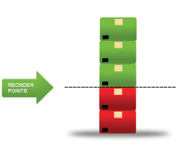
INVENTORY OPTIMIZATION
Data is formatted and monthly demand is calculated for each material.
Lead time is calculated and merged with the demand data.
Demand during lead time and standard deviation are calculated for each material.
Reorder point is calculated using desired service level and safety factor.
Reorder point and safety stock are specified for each material.

Slide 13
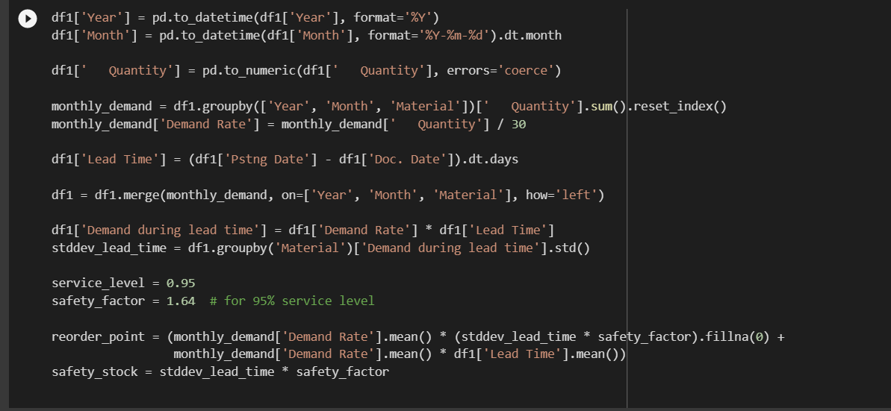
CODING

Slide 14
THANK YOU.

